Slide 1

FAITHFULNESS IN GIVING
STEWARDSHIP HOUR
LUKE 16:11; 1 COR. 4:2

Slide 2
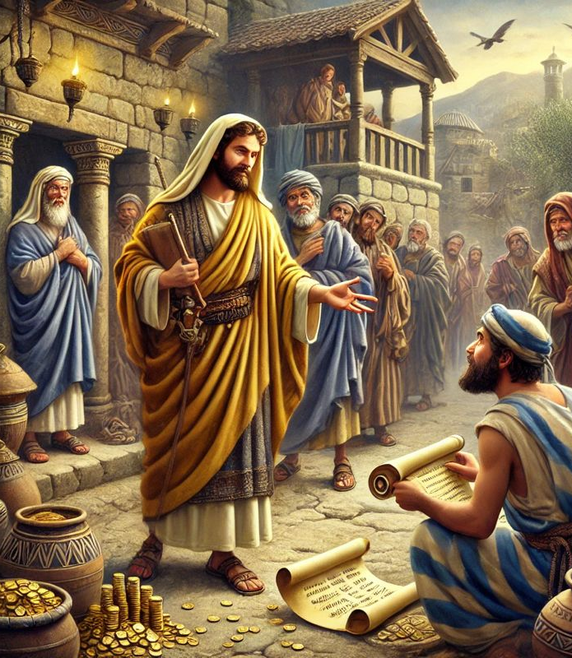
Introduction
Luke 16:1-13 describes a steward who cheats his master but is commended for his prudence.
After mismanaging the master’s business and being required to give an account, leading to his dismissal, this steward connived with his master’s debtors and kept part of what they owed his master for himself

Slide 3
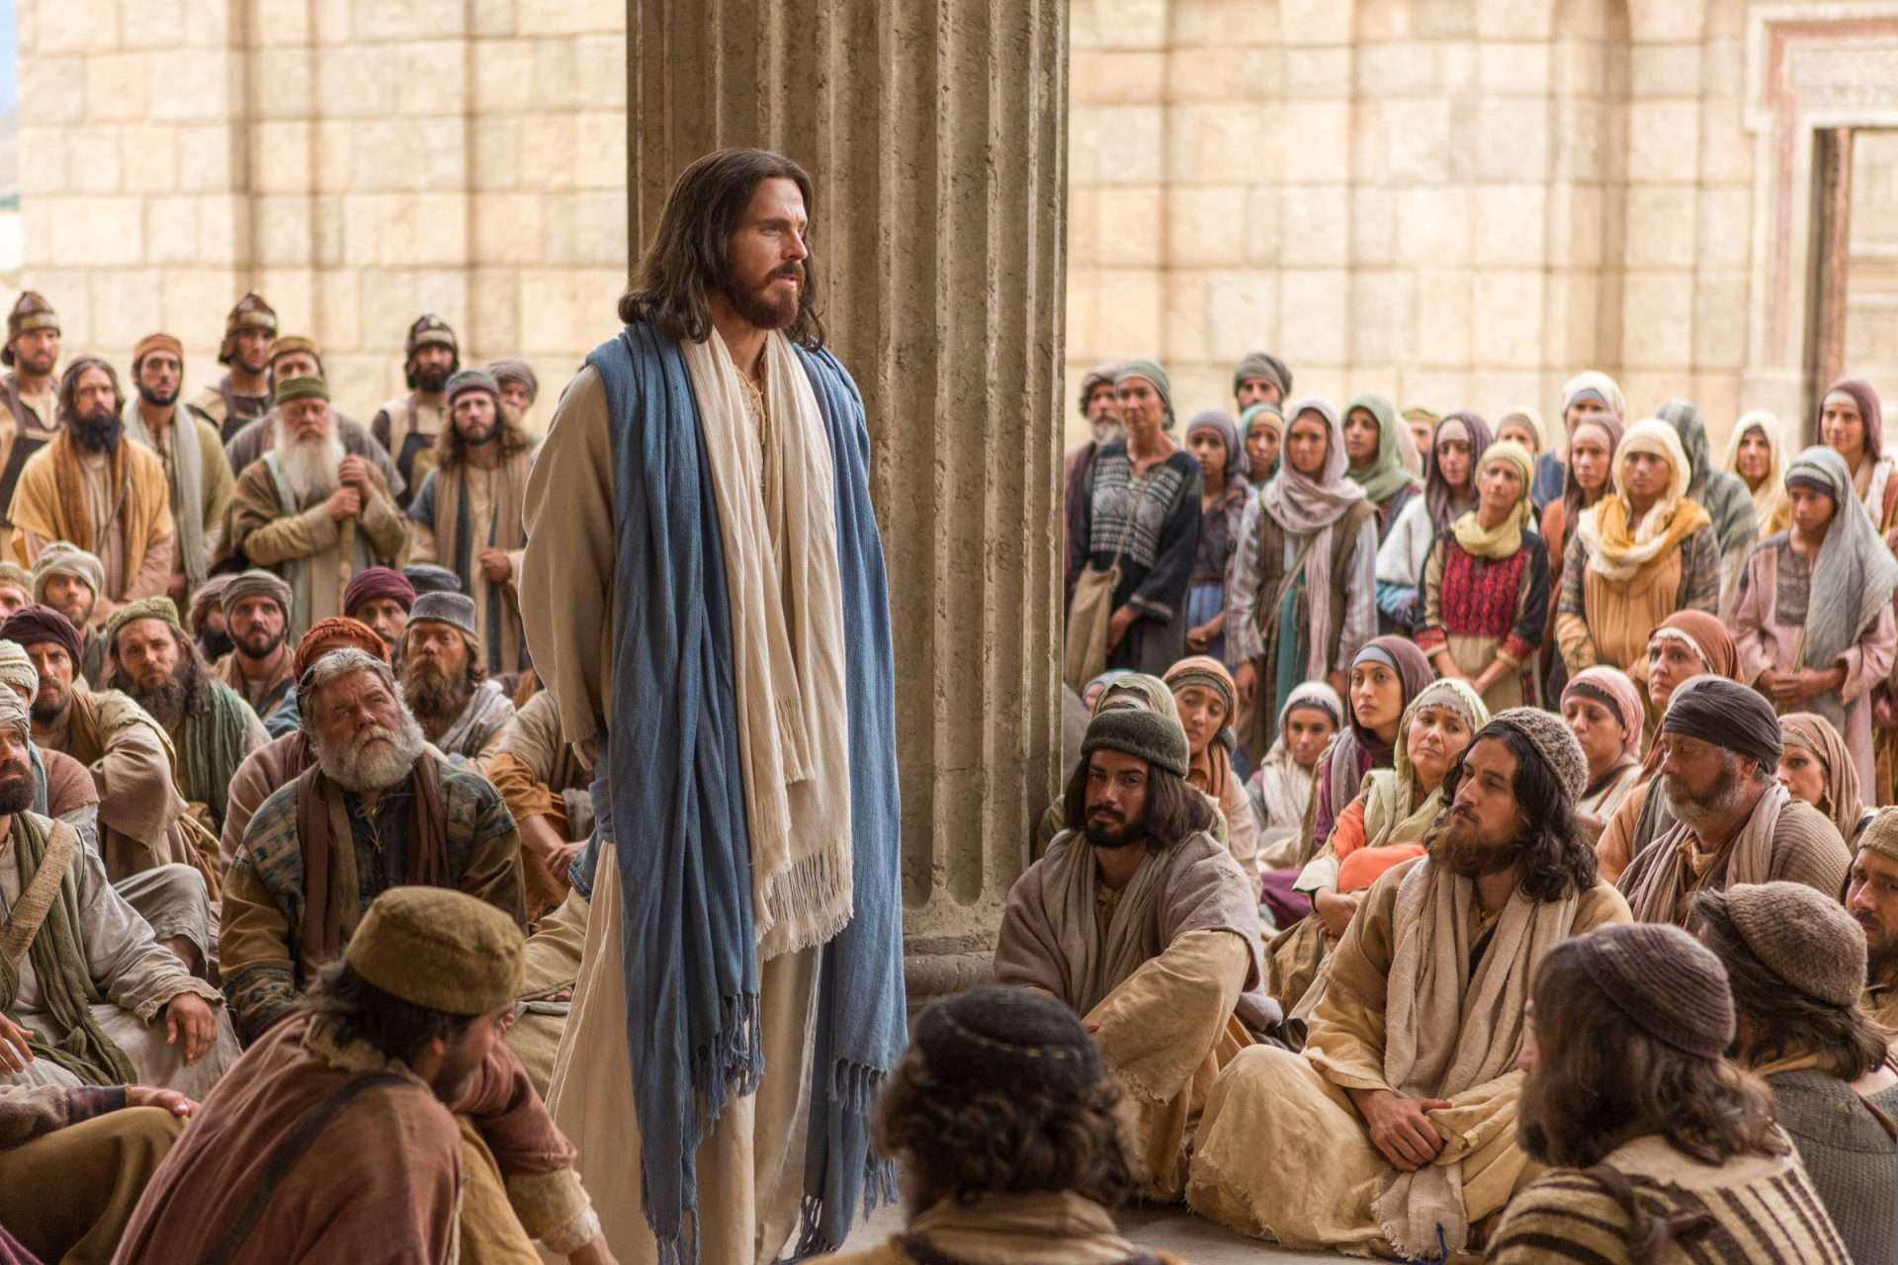
Notwithstanding, Jesus uses the parable to inculcate in his disciples the need to emulate the behavior of this dishonest but shrewd steward. Which character of this steward did the master praise?
Notes:
How could Jesus possibly hold the steward up as an example for his followers? From this parable, Jesus taught an important lesson on faithfulness in stewardship (v.11

Slide 4
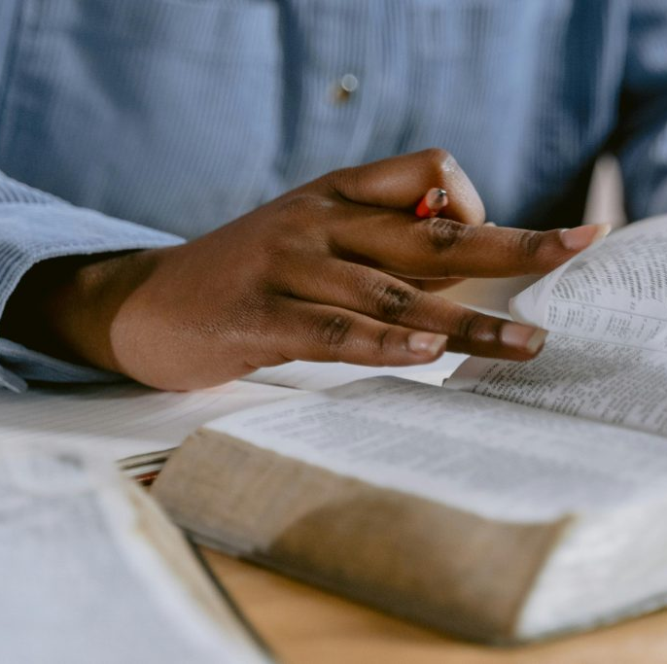
Since many scholars interpret this parable differently, the best approach is that the steward, however dishonest in his business dealings, sensibly saved for his future from what he let the creditors keep (vv. 7-8)
Notes:
His prudenceis making “friends for yourselves by means of the mammon of unrighteousness” (Lk. 16:9 NAS).

Slide 5

Thus, faithfulness in the use of unrighteous mammon is using wealth for its intended purpose: giving to assist the needy

Slide 6

Stewardship Is Caring For God’s Creation

Slide 7

The concept of Stewardship discusses God as the Creator and Owner, and humans as stewards caring for God’s property.
Adam, as the first steward was charged to work and keep Eden (Gen. 2:15). “To keep” could mean care for, protect (Job 39:1), or preserve (Ps 97:10), watch over (Ps 121:4).

Slide 8

God never abandoned humans after sin but sought their welfare (Gen. 1:26; 3:9).
Thus God’s calling, "Where are you?" (Gen. 3:9 NKJ) reveals His empathy for the sinful humans. Similarly, God expected humans to exemplify this attitude of empathizing with fellow humans.

Slide 9
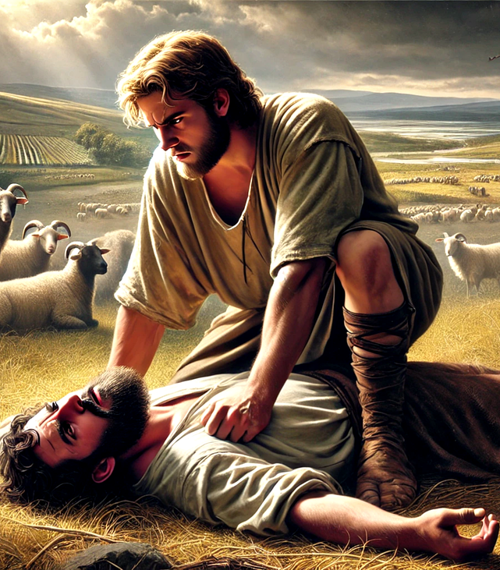
God expected Cain to care for his brother (Gen 4:8-12). So He asked Cain, "Where is Abel, your brother?" (Gen. 4:9 NKJ)
Therefore, looking after God’s property is caring for God’s humanity: it is about being your brother’s keeper. This concept of being your neighbor’s keeper is Christ’s teaching on faithful Stewardship.

Slide 10

Faithfulness In Managing The Lord’s Wealth

Slide 11

Most interpreters agree that the parable in Luke 16:1-13 deals with the use and abuse of riches (16:1-31), an emphasis supported by Luke's repeated use of mammon (wealth) in vv. 9, 11, 13, and philargyros (lover of money) in v. 14.

Slide 12
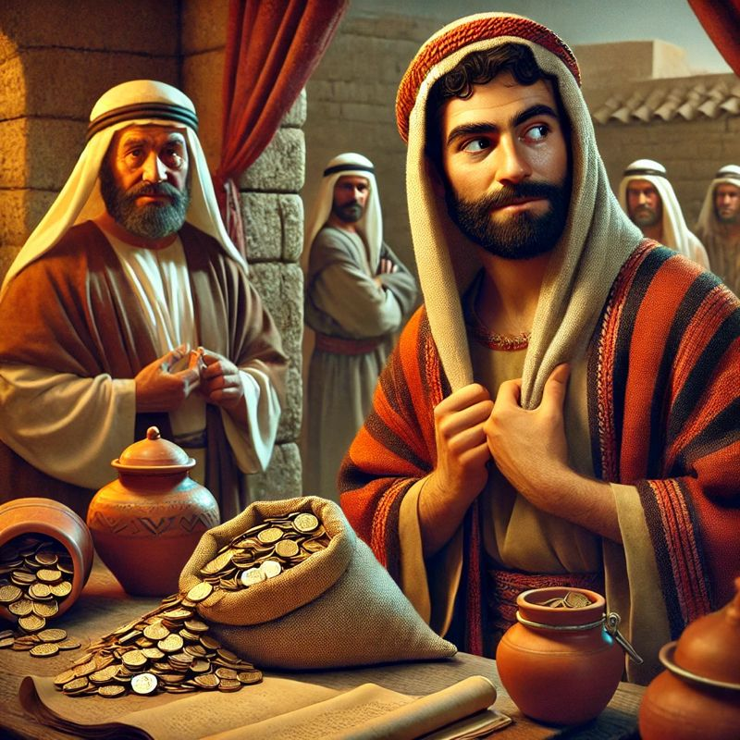
This is a steward who has shown dishonesty in business, but in an unusual turn the master commends him for prudence and foresight (v. 8; 12:42).
The Parable describes the activities of the ‘sons of the world’ as opposed to the ‘sons of light’ (v. 8b).
Such activities are described in verse 1 as squandering the master’s possessions.

Slide 13
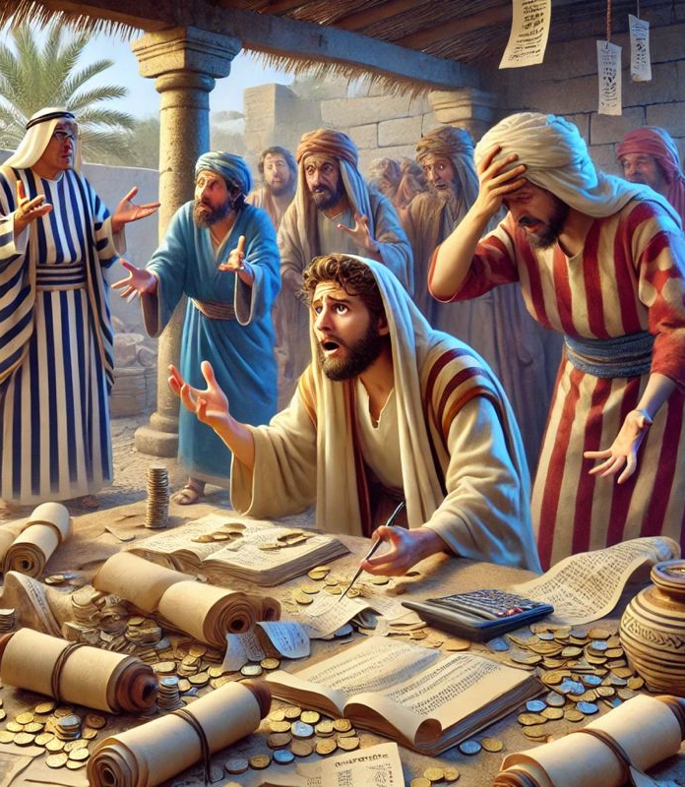
And this was the steward’s mismanagement of someone’s business (v. 4, 12).
This dishonest and unfaithful behavior of the steward was never praised.

Slide 14
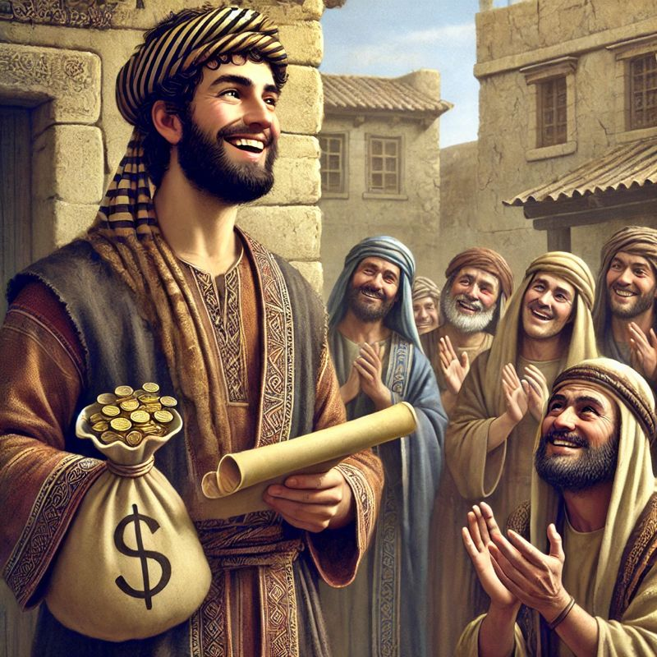
“The worldly man praised the sharpness of the man who had defrauded him.
But the rich man’s commendation was not the commendation of God. Christ … made use of a well-known occurrence to illustrate the lesson He desired to teach.” COL 367

Slide 15
“Christ does not commend the unjust steward for his dishonesty. He commends those who do not live for their own selfish interest…” (MS. 4, 1900).
Notes:
Logic is inherent in this verse: if the sons of this world are shrewd in their worldly transactions, then much faithfulness is required from the sons of light.Jesus' disciples should use their wealth for spiritual goals.

Slide 16
In the parable, it is the shrewdness of the steward that the master praised, and this is described as making “friends for yourselves by means of unrighteous mammon” (Lk. 16:9).

Slide 17

The word "mammon" from Aramaic could mean something that people put their trust in, hence, wealth.
This wealth is not the possession one acquires dishonestly but worldly treasure as opposed to heavenly treasure (v. 11).

Slide 18
The requirement of faithfulness in the management of wealth shows that humans are stewards, not owners of wealth. This material wealth, through charitable giving, should be utilized to win friendships because wealth will ultimately cease to exist; none will remain.

Slide 19

How well we handle worldly money (little things) tests our ability to handle heavenly wealth.
In contrast, one's loyalty or unfaithfulness decides how they end.
This suggests that loyalty in small things (v. 10) equals faithfulness in unjust mammon (v. 11) and in another’s property (v. 12).

Slide 20
As beginners, God usually starts us with small financial management. If we pass the test, He grants us actual heavenly riches to handle (vv. 11, 12).
However, if we begin with unfaithfulness in small things, then we shall remain unfaithful in much and other people’s property.
Unfaithful people cannot receive true heavenly treasures.

Slide 21

Proper financial management also entails helping others, especially the vulnerable, with what the Lord has entrusted into your hands.
Furthermore, the effective use of worldly possessions tests one's ability to handle true riches and reveals where ultimate loyalties lie (v. 13).

Slide 22
Loyalty to God determines one’s ability to hold true wealth and material possessions

Slide 23
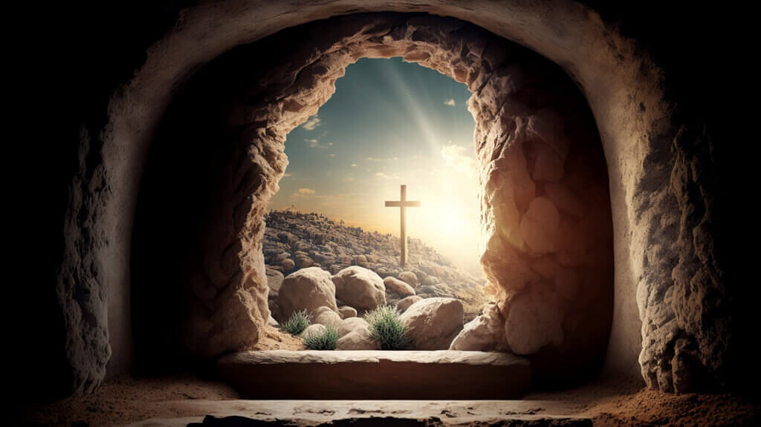
Jesus Faithfully Accomplished His Mission

Slide 24

The prophecy about the Messiah's mission preempts Christ's work to alleviate the plight of the vulnerable.
(Isa. 61:1-2 NKJ).

Slide 25
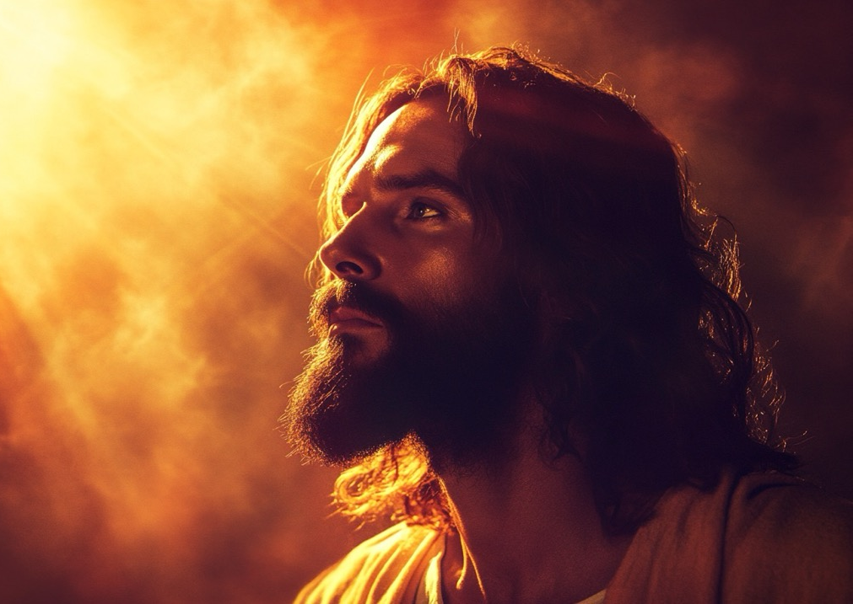
This was exactly what He came to do, hence, it was not just a coincidence when He ascribed to Himself the content of this prophecy.
(Lk. 4:18-19 ESV)

Slide 26
The signs of the Messianic age were all fulfilled in the work of Christ.
Jesus was the preacher of the good news (Luke 8:1).
He healed the blind (Matt. 12:22; Mark 10:46-47; 11:5).
He set at liberty those in spiritual as well as physical captivity.
Notes:
Jesus could accomplish His mission under the anointing of the Holy Spirit(read: Acts 10:38; 2Cor. 8:9).Jesus’ caring for humanity has it purpose to win souls.

Slide 27

Caring For The Vulnerable

Slide 28
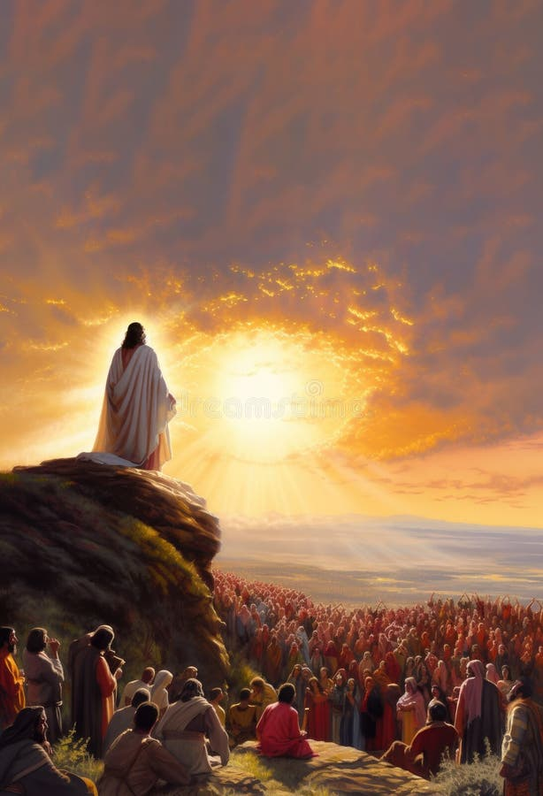
Some of Jesus' parables about stewardship were intended to teach the disciples about the responsibility to provide for the weak(Matt. 25:34-36).
The faithful and compassionate Christian will provide for the needs of the less privileged.

Slide 29
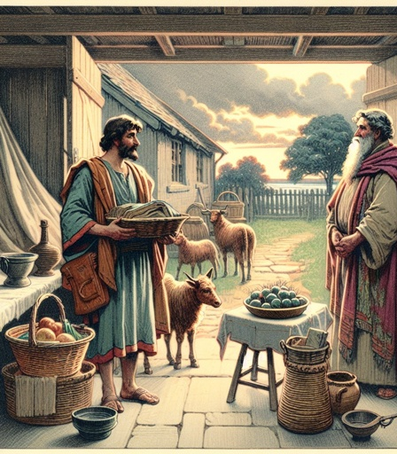
The wise slave in the context of Matt. 24:45-47, had his position changed from an ordinary slave to a caretaker (steward) responsible for fellow slaves.
If he does well, he will be responsible for all the master’s property.

Slide 30
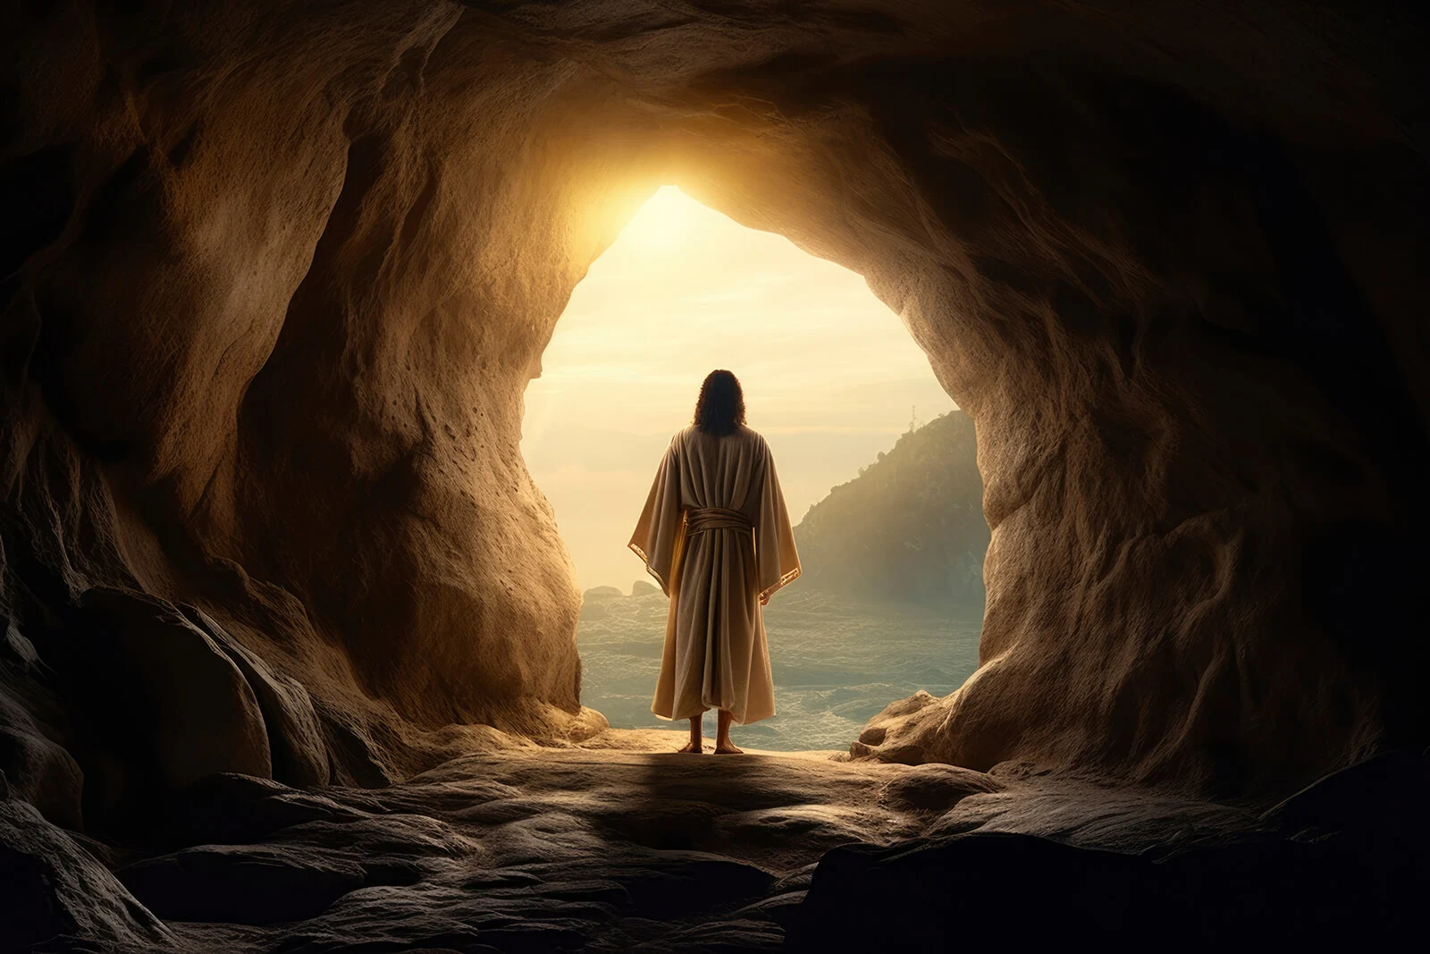
Jesus accomplished a successful mission through the power of the Holy Spirit (Acts 10:38).
Thinking about an accomplished mission, the disciples wanted the Kingdom to be given to Israel.

Slide 31
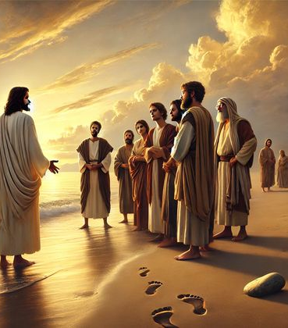
(Acts 1:6 ESV).
Yet the “but” of Christ’s statement (v. 8) opposes the disciples’ thinking of an accomplished work.
Although they assisted Jesus in His mission (Luke 10:1, 17-20), their actual mission was to begin after they received the Holy Spirit

Slide 32

The Early Church Faithfully Gave

Slide 33
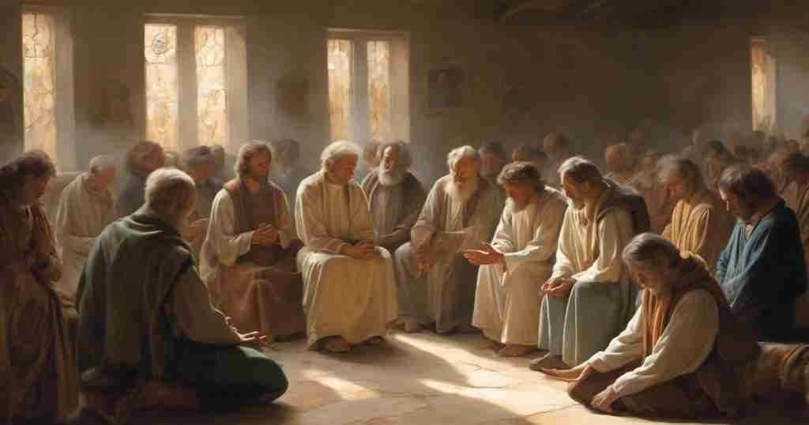
The Early Church could proclaim the good news to win souls and provide sustenance for the vulnerable after they received the Power of the Holy Spirit. (Acts 2:38-41; 4:4).
(Acts 2:44-45)
Notes:
Thus, they needed to give their means to support the Lord’s work (vv. 46-47; 4:32-37). The faithful members brought their offerings“and laid them at the apostles' feet; and they distributed to each as anyone had need”(Acts 4:35 NKJ).
Probably, the distribution to ‘EACH’ did not describe all the members, but the vulnerable.
Therefore, the NIV translation appears more probable: “and it was distributed to anyone who had need” (Acts 4:35 NIV).

Slide 34
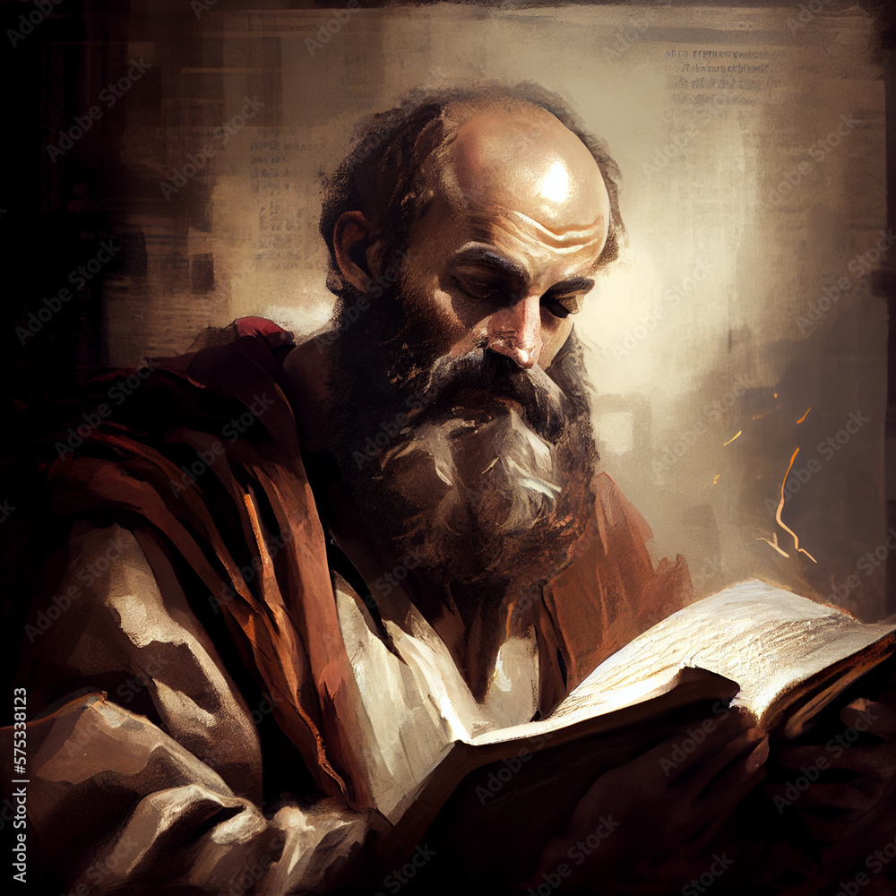
Apostle Paul in Acts20:35 admonished the saints to work hard to gain resources “…to help the weak, and to remember the words of the Lord Jesus, that he himself said, It is more blessed to give than to receive.”

Slide 35

Be Faithful In Caring

Slide 36

Both the Old and New Testaments urge the Church and individuals to care for the vulnerable.
Although we must be unselfish to provide for the poor, God did not intend for anyone to become destitute.
(Deut. 15:4 ESV).
Notes:
.“But there will be no poor among you; for the LORD will bless you in the land that the LORD your God is giving you for an inheritance to possess” (Deut. 15:4 ESV). Yet, some circumstances can cause some to become poor. And in such a situation, God expected the rest of the community to be compassionate and generous towards the poor. (read Deut. 15:7-8 ESV).
This admonishment was given on the premise that“…there will never cease to be poor in the land. Therefore, I command you, 'You shall open wide your hand to your brother, to the needy and the poor, in your land' (Deut. 15:11 ESV).

Slide 37
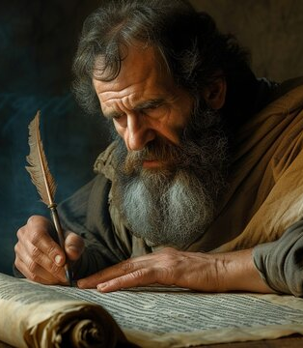
But who constitutes the poor?
Paul’s admonition clarifies who qualifies as vulnerable to receive the church's and individuals' assistance,1 Tim. 5:3-4 NKJV.
Some people may be widows, widowers, or orphans, but if they can receive family support, the church may not carry their burdens

Slide 38
The weak in this sense may include the aged, the disabled, or those who may have lost everything due to a disaster.
Paul admonishes that all who have the strength and opportunity must work to earna living (read 2 Thess. 3:10-14).

Slide 39

What We Are To Give In Faithfulness

Slide 40
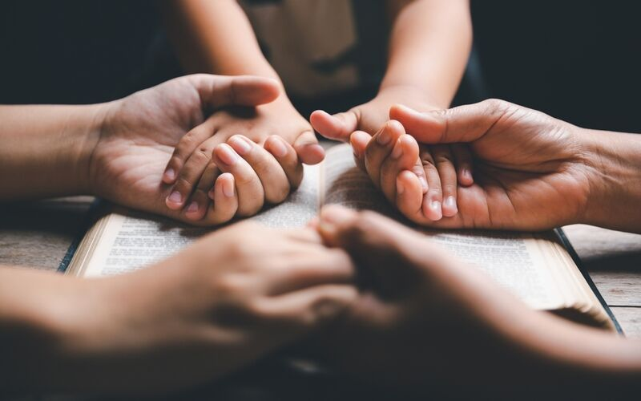
When the Early Church wanted to do Christ’s mission, they came together and prayed.
Then the Holy Spirit descended (Acts 4:31)and united them for a common mission purpose (v.32a).
They eschew all forms of selfishness and worked on the problems affecting fellow members (v.32b).

Slide 41

With the common purpose and their desire to unite and work in the interest of all, they could witness with great power about the resurrection of Christ (v. 33).
With the same power of the Holy Spirit, they were energized to give their means in support of the mission (vv. 33-37).
When the Church receives sufficient funds, its mission advances.

Slide 42

Let’s pray that each member will faithfully support the gospel commission with the means the Lord provides (1 Cor. 4:1-2).

Slide 43

Faithfully Return Your Tithe

Slide 44
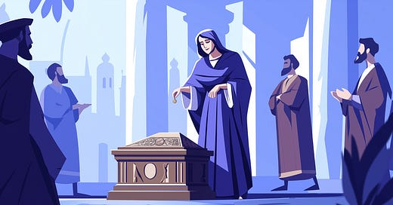
Just as the Lord gave the tithe to support the Levites for their ministry at the tent of meeting, Paul in a similar fashion believes that the gospel ministers who hold a similar position should be supported from the gospel ministry (1 Cor. 9:14).

Slide 45
The support for those employed in the temple and the altar services (1 Cor. 9:13 ESV) constituted the Lord’s Tithe (Num. 18:21).
Paul commended the Philippians for offering enough means for his necessities.

Slide 46
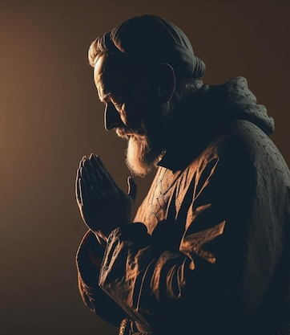
The abundance they gave for his support was “… a sweet-smelling aroma, an acceptable sacrifice, well pleasing to God.” (Phil. 4:18 NKJ).
And thus Paul’s prayer for the Philippians and all who faithfully support the gospel ministry with their means is that:
“And my God shall supply all your need according to His riches in glory by Christ Jesus” (Phil. 4:19 NKJ).

Slide 47
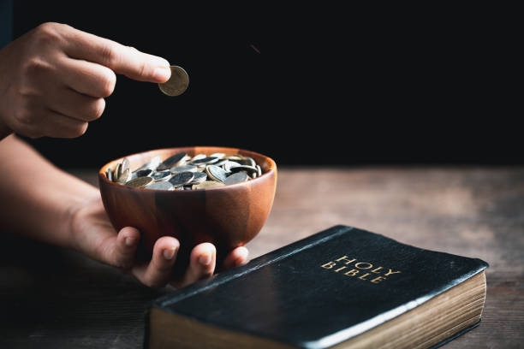
Faithfully Give Combined Offering

Slide 48

The Lord’s Combined Offering is your regular systematic offering that you bring in worship whenever the Lord blesses you with an income

Slide 49

It is combined because the worshiper brings their offering in bulk, and each level of the church prepares a budget to allocate to each department and institution according to their needs.
Notes:
Just like in the Early Church, the members brought their means (offering) and the apostles made the allocation (in their budget) according to the needs of the vulnerable (Acts 4:35). We entreat every level of the church to allocate a substantial amount in their yearly budget to take care of the needy.

Slide 50

Conclusion
As a mission-oriented Church, the Seventh-day Adventists are to preach the good news of salvation to people groups of the world.
This mission is to be accomplished through the means the Lord has placed at the disposal of each of His faithful servants.

Slide 51
We have a generation to win for Christ, hence, every member of the Church should join in this soul-winning mission.
The Church must pray to receive the power of the Holy Spirit to work with our talents and spiritual gifts and grow the church.

Slide 52
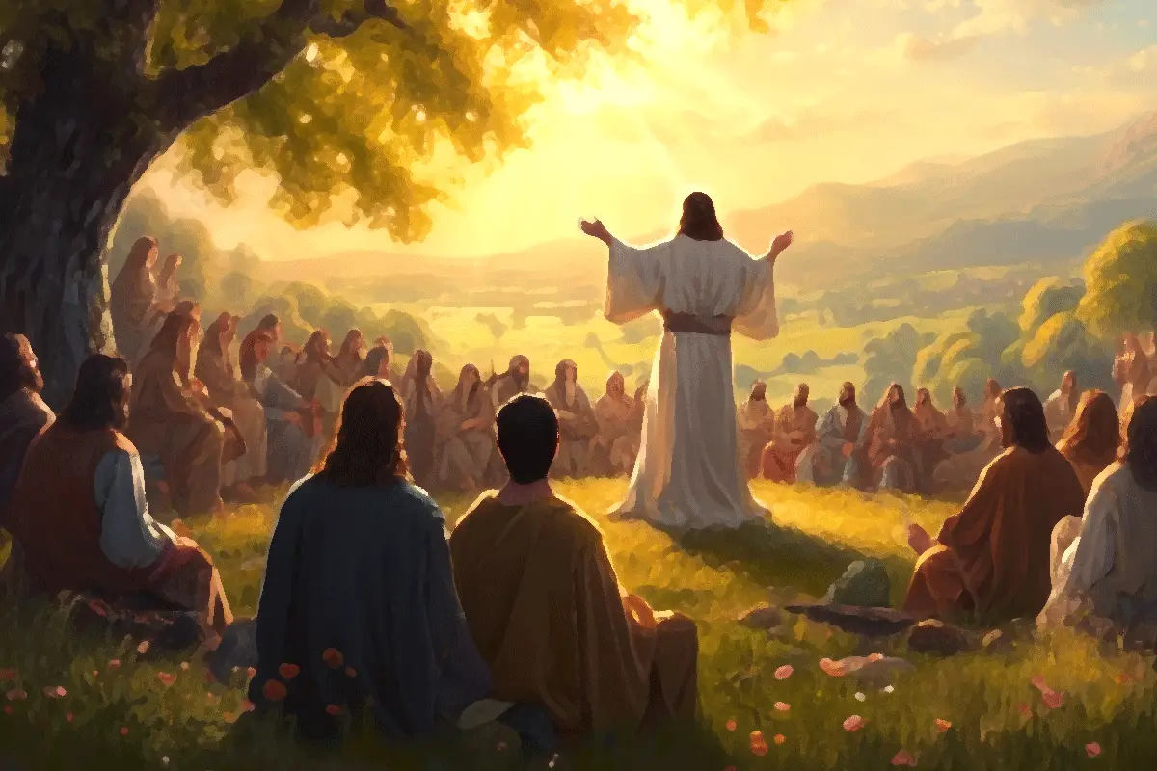
We have learned from Jesus’ parable of the unjust steward that making friends with worldly wealth involves helping the needy and vulnerable with the riches the Lord provides.

Slide 53

Don’t make a god out of your wealth; your loyalty instead must be directed to God because people who put their trust in riches (Luke 12:16; Matt. 6:21) cannot love God (Matt. 6:24).
It is the prudence, not dishonesty, that the master applauded.

